Slide 1


SINAI (SUHI) PROJECT
Motorola Solutions Foundation Scholars Program
January 17th
Minh Nguyen

Slide 2
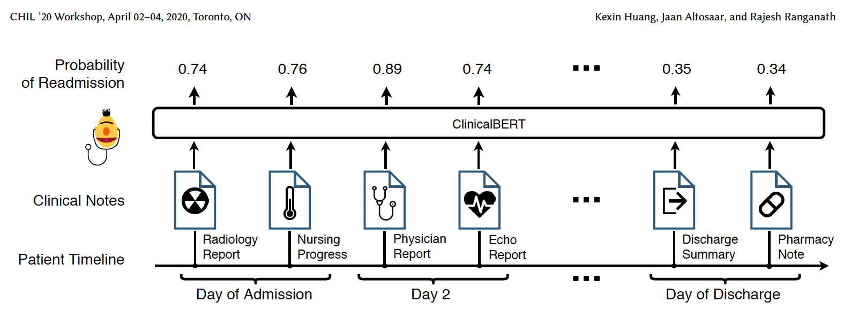
RESEARCH QUESTION
How can we leverage the note to improve the classification model?

Slide 3
CURRENT WORK
Reading research papers about ClinicalBERT [1] and about readmission rate at hospitals [2] [3] -> Finished
Try running the classification model (RF) code for the surveyed, non-engaged, and engaged notes -> WIP
Doing a short summary document about the research papers that I read -> WIP
[1] Huang, Kexin. Altosaar, Jaan. Ranganath. “ClinicalBERT: Modeling Clinical Notes and Predicting Hospital Readmission”. November 29th, 2020. CHIL ‘20 Workshop. arXiv.
[2] Hernandez, Nuvia. Karam, Kate. Baugh, Nicole. Musale, Shilpa. Moses, Aditya Patrick. Raicu, Daniela. Furst, Jacob. McCabe, Kelly. Tchoua, Roselyn. “Leveraging Community Health Workers for Predicting Emergency Department Readmissions”. February 8th, 2024. International Journal of Semantic Computing.
[3] Swinburne, Mathew. Garfield, Katie. Wasserman, Aliza R. “Reducing Hospital Readmissions: Addressing the Impact of Food Security and Nutrition”. 2017. 2016 public health law conference – Spring 2017.

Slide 4
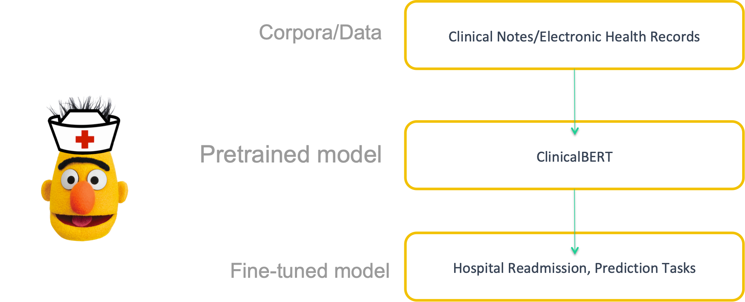
OVERVIEW
BERT (Bidirectional encoder representations from transformers) is a machine learning framework for natural language processing developed by Google.
ClinicalBert is Bert that specialized to medical notes
BERT is trained on Wikipedia and BooksCorpus. Meanwhile, CLINICALBERT is trained on clinical notes to predict hospital readmission rate
Clinical notes are hard to use in machine learning models due to their unusual grammar structures, high–dimensional, and spare information

Slide 5
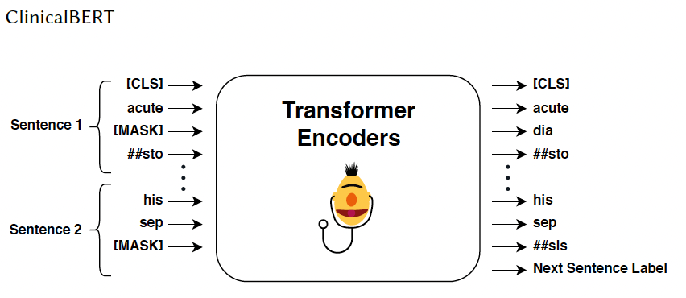
PRETRAINED MODEL
It pre-trained on medical notes from the MIMIC-III dataset.
It used masked language modeling and next-sentence prediction. In masked language modeling, a fraction of the input token (Clinical notes were split into tokens) are held out for prediction; in next sentence prediction, ClinicalBERT predicts whether two input sentences are consecutive.
It used the SpaCy library for rule-based sentence segmentation to handle clinical note grammar and abbreviations.
For the preprocessing part, it converted all text to lowercase and removed special characters, line breaks, and carriage returns.

Slide 6
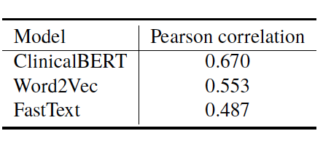
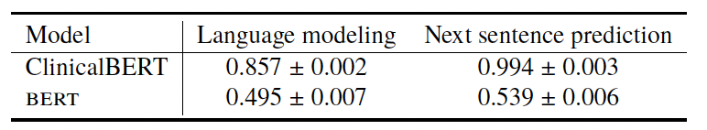
RESULTS
CLINICALBERT outperformed other competitive deep language models in the case study of hospital readmission prediction.
CLINICALBERT is better than BERT in terms of average accuracy of masked language modeling and next-sentence prediction.
In terms of capturing clinical word similarity, CLINICALBERT has a more accurate result compared to the other two popular models of clinical text, Word2Vec, and FastText.

Slide 7
FUTURE WORK
Understand the pre-processing step after I run the classification model (RF) code.
I will do some experiments by adding notes into tabular data and combining it to count how the number of notes and create a correlation matrix.
I will find if two numbers match for several categories between tabular and resource notes, such as transportation needs, utilities, employment, food security, etc… (0 for need, 1 for don’t need). Check if are there any notes left behind for both old and new resource notes for a particular patient (record ID).

Slide 8
SINAI (SUHI) PROJECT
Motorola Solutions Foundation Scholars Program
January 24th
Minh Nguyen

Slide 9
CURRENT WORKS
Writing a summary of the research paper that I read that is relevant to MEDICALBERT -> Finished
Create correlation matrix for the data of old data and new data -> Finished
For patients with multiple rows, identify any SDOH categories that are repeated between the visit -> Finished
Find if two numbers match (repeat) for transportation needs and other SDOH categories in both old and new data -> WIP

Slide 10
CURRENT WORK
The formula that I used to calculate the correlation coefficient is Pearson correlation coefficient
0.81 between sdoh2st_anxiety and sdoh2st_depression
0.7 between sdoh2st_lonely and sdoh2st_anxiety
0.6 between sdoh2st_loneyly and sdoh2st_depression

Slide 11
FUTURE WORK
Double-check if my code is correct for the correlation matrix for the old and new data
Double-check my code to identify which categories that are repeated between the visits to make sure everything is correct
Finishing finding if two numbers match (repeat) for transportation needs and other SDOH categories in both old and new data. Check if there are notes left behind for both old and new resource notes for a particular patient

Slide 12
SINAI (SUHI) PROJECT
Motorola Solutions Foundation Scholars Program
January 31th
Minh Nguyen

Slide 13
RESEARCH QUESTION

Slide 14
HYPOTHESIS

Slide 15
METHODOLOGY

Slide 16
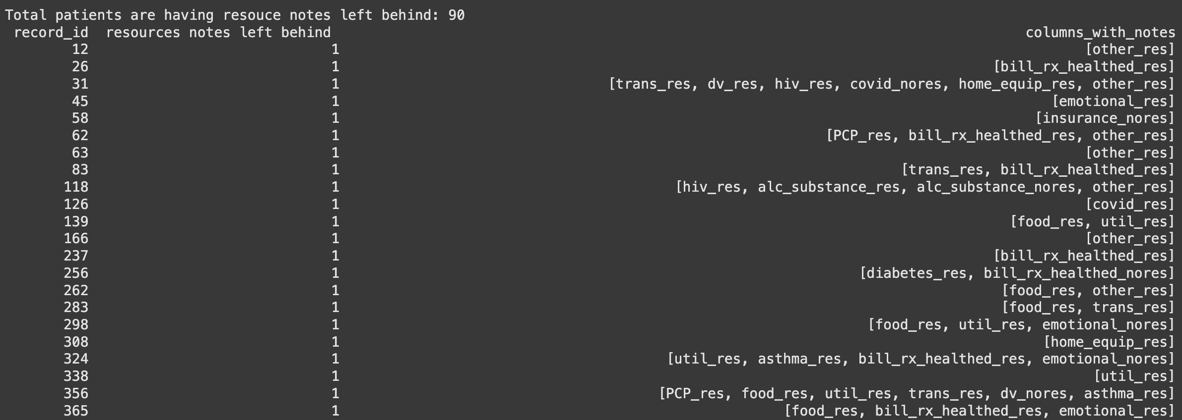
CURRENT WORKS
Check patients who have resource notes (1 means have, 0 (removed) means don’t have) left behind for both visits. -> Finished

Slide 17
NEXT STEPS
Create a column indicating if the SDOH tabular data number matches resource notes.
Create a mapping between tabular and resources notes column name
record_id | Sdoh_trans (tabular) | Trans_res (categorical) | Complete_data
2 | 0 ( don’t need) or 1 (need) | 1 (have notes) | 1
4 | 0,1 | N/A | 2
6 | N/A | 1 | 3
8 | N/A | N/A | N/A

Slide 18
QUESTIONS

Slide 19
PREDICT READMISSION RATE BASED ON SDOH CATEGORIES FOR SINAI HOSPITAL (SUHI) PROJECT
Motorola Solutions Foundation Scholars Program
February 17th
Minh Nguyen

Slide 20
RESEARCH QUESTION
How does the frequency of resource notes correlate with patient readmission patterns in the dataset?

Slide 21
HYPOTHESIS
Patients who receive a higher number of resource notes are more likely to have higher readmission rates compared to those who receive fewer or no resource notes.

Slide 22
CURRENT WORK
Check all patients (instead of patients who have multiple visits) to indicate who has any resource notes left behind. -> Finished
Count the frequency of each resource note and identify the most frequently noted resources. -> Finished
Calculate the total readmit rate for each type of resource notes -> Finished

Slide 23
RESOURCES NOTES FREQUENCY
There are 441 patients in total who have resources notes left behind
Categories | Frequency (times)
other_res | 134
bill_rx_healthed_res | 100
trans_res | 92
food_res | 91
util_res | 83

Slide 24
READMISSION RATE FOR EACH CATEGORIES
Some resources show high readmission rates, meaning patients who had these noted were more likely to return
Categories | Frequency | Total Readmitted | Readmission Rate
asthma_res | 10 | 4 | 40%
PCP_res | 5 | 2 | 40%
employ_nores | 8 | 3 | 37.5%
emotional_res | 30 | 10 | 33.33%

Slide 25
NEXT STEPS
Read through the document about Yule Q that Dr. Tchoua sent
Analyze whether patients with food resources (food_res) have different readmission rates compared to those without (food_nores) by applying Yule-Q.

Slide 26
PREDICT READMISSION RATE BASED ON SDOH CATEGORIES FOR SINAI HOSPITAL (SUHI) PROJECT
Motorola Solutions Foundation Scholars Program
February 21th
Minh Nguyen

Slide 27
RESEARCH QUESTION
Big RQ: How can we leverage Community Health Worker (CHW) notes to supplement tabular features and improve the classification of ED readmissions?
How does the frequency of resource notes correlate with patient readmission patterns in the dataset?

Slide 28
HYPOTHESIS
Patients who receive a higher number of resource notes are more likely to have higher readmission rates compared to those who receive fewer or no resource notes.

Slide 29
READMISSION RATE FOR EACH CATEGORIES
Some resources show high readmission rates, meaning patients who had these noted were more likely to return
Categories | Frequency | Total Readmitted | Readmission Rate
asthma_res | 10 | 4 | 40%
PCP_res | 5 | 2 | 40%
employ_nores | 8 | 3 | 37.5%
emotional_res | 30 | 10 | 33.33%

Slide 30
CURRENT WORK
Read through the document about Yule Q that Dr. Tchoua sent -> WIP
Writing an abstract for CAURS 2025 -> WIP
Create a barplot to show the distribution of readmission rates across the categories -> WIP
Analyze whether patients with food resources (food_res) have different readmission rates compared to those without (food_nores) by applying Yule-Q.

Slide 31
NEXT STEPS
Analyze whether patients with food resources (food_res) have different readmission rates compared to those without (food_nores) by applying Yule-Q.
Create a barplot to show the distribution of readmission rates across the categories
Look over ClincicalBert and Doc2Vec (NLP models), then read the notes as sentences and write them as classifiers.

Slide 32
PREDICT READMISSION RATE BASED ON SDOH CATEGORIES FOR SINAI HOSPITAL (SUHI) PROJECT
Motorola Solutions Foundation Scholars Program
March 3rd
Minh Nguyen

Slide 33
RESEARCH QUESTIONS
Do patients who have a specific resource (e.g., emotional support, food assistance) will have different hospital readmission rates compared to patients who do not have that resource?

Slide 34
HYPOTHESIS
H: There is a significant correlation between having the resources and the readmission rate.

Slide 35
CURRENT WORK
Read through the document about Yule Q that Dr. Tchoua sent -> Finished
Create a barplot to show the distribution of readmission rates across the categories -> Finished
Analyze whether patients with food resources (food_res) and other kind of categories have different readmission rates compared to those without (food_nores) by applying Yule-Q -> Finished
Writing an abstract for CAURS 2025 -> Finished
Look over ClincicalBert and Doc2Vec (NLP models), then read the notes as sentences and write them as classifiers -> WIP

Slide 36
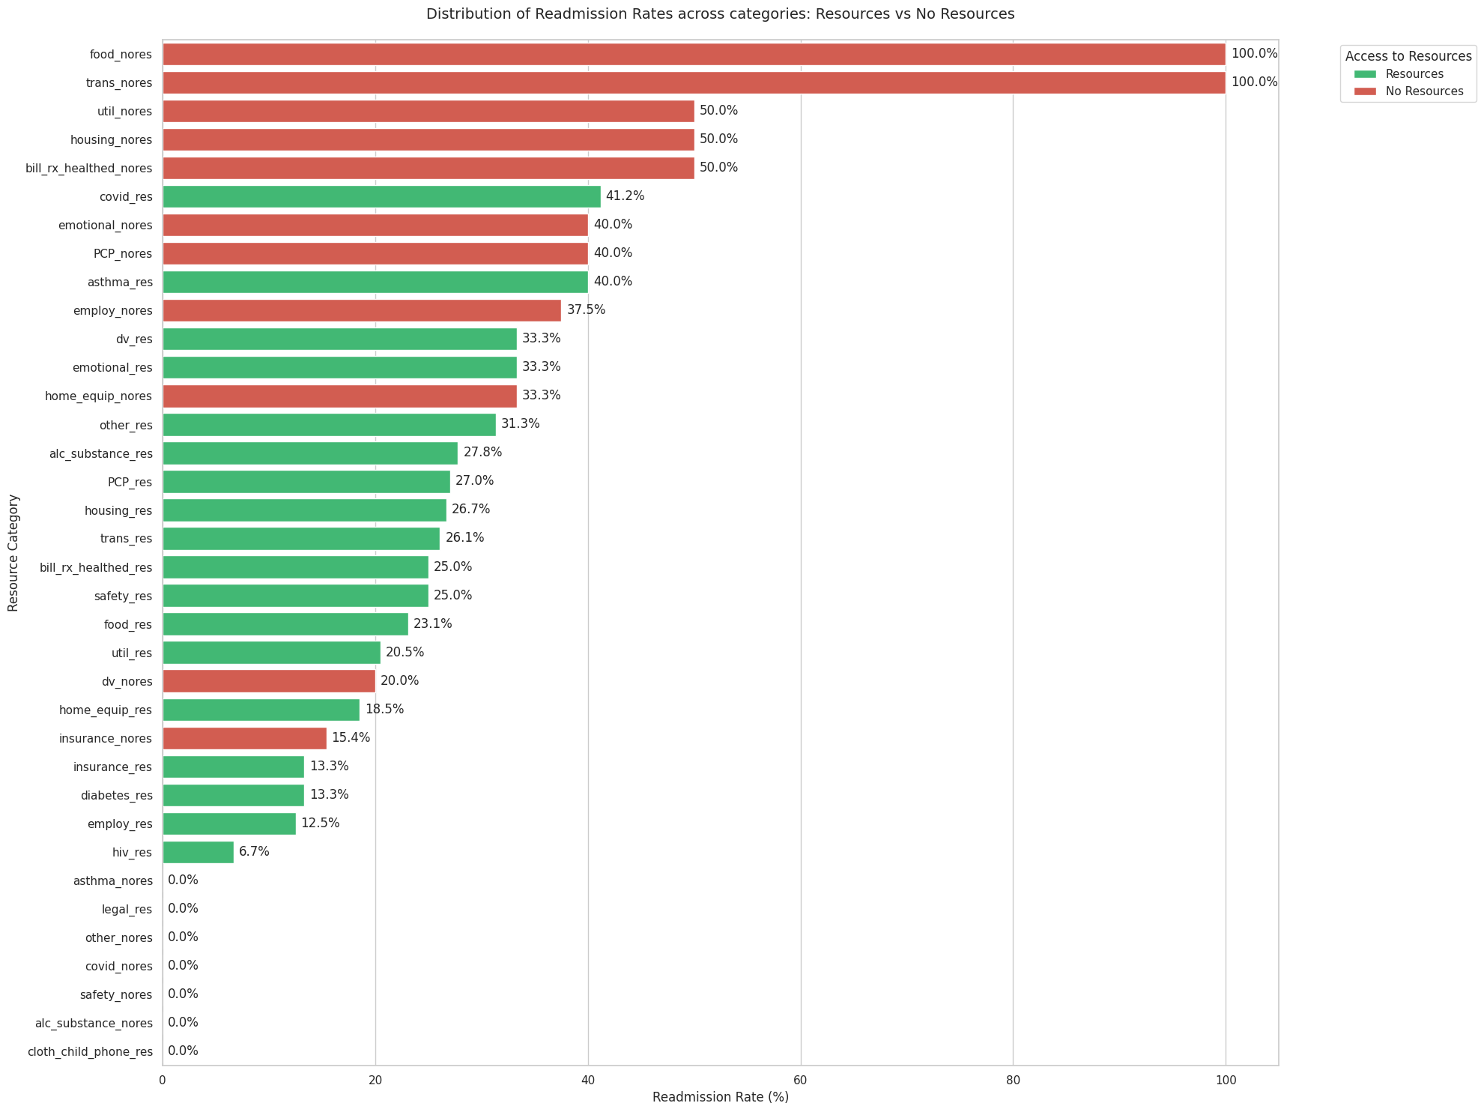

Slide 37
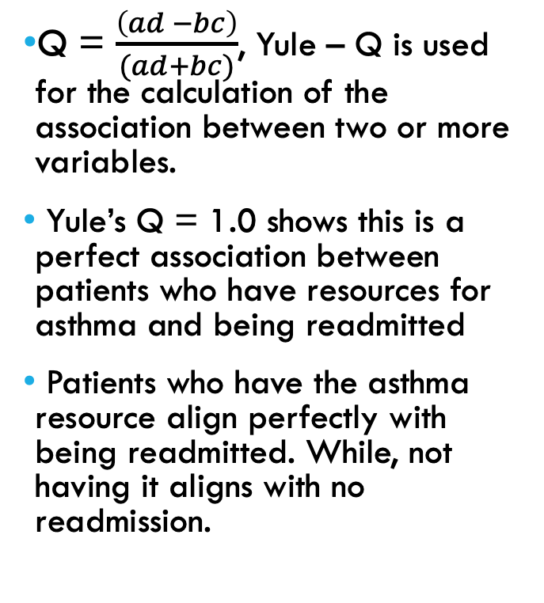
READMISSION RATE BETWEEN ASTHMA_RES VS ASTHMA_NORES
Yule – Q = 1.0 | Readmitted | Not Readmitted
asthma_res | 4 (a) | 6 (b)
asthma_nores | 0 (c) | 2 (d)

Slide 38
READMISSION RATE BETWEEN EMOTIONAL_RES VS EMOTIONAL_NORES
Yule’s Q = -0.14, which indicates a slight negative correlation between having the emotional resources and being readmitted
Patients with the emotional resource are less likely to be readmitted than those without it.
Yule – Q = - 0.14 | Readmitted | Not Readmitted
Emotional_res | 10 | 20
Emotional_nores | 2 | 3

Slide 39
READMISSION RATE BETWEEN EMPLOY_RES VS EMPLOY_NORES
Yule’s Q = -0.61 shows this is a moderate negative correlation between patients who have the employment resource and being readmitted.
Patients with the resource tend to have lower readmission rates than those without it.
Yule - Q = - 0.61 | Readmitted | Not Readmitted
employ_res | 3 | 21
employ_nores | 3 | 5

Slide 40
READMISSION RATE BETWEEN PCP_RES VS PCP_NORES
Yule’s Q = -0.28, this shows a slightly negative correlation between patients who have the primary care provider resource and being readmitted.
Patients with the resource tend to have lower readmission rates than those without it.
Yule – Q = - 0.28 | Readmitted | Not Readmitted
PCP_res | 10 | 27
PCP_nores | 2 | 3

Slide 41
NEXT STEPS
Learn more about ClincicalBert and Doc2Vec (NLP models)
Read the notes as sentences and write them as classifiers

